Slide 1

Lesson 2: Functions

Slide 2
About this lesson
Lesson 2: Functions
Programs in Kotlin
(Almost) Everything has a value
Functions in Kotlin
Compact functions
Lambdas and higher-order functions
List filters
Summary

Slide 3
Programs in Kotlin

Slide 4
Setting up
Before you can write code and run programs, you need to:
Create a file in your project
Create a main() function
Pass arguments to main()(Optional)
Use any passed arguments in function calls (Optional)
Run your program

Slide 5
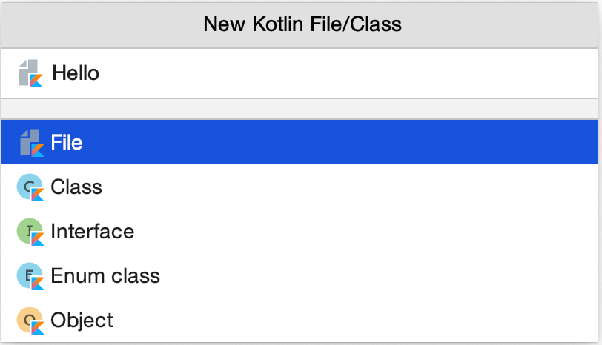
Create a new Kotlin file
In IntelliJ IDEA's Project pane, under Hello World, right-click the src folder.
Select New > Kotlin File/Class.
Select File, name the file Hello, and press Enter.

Slide 6
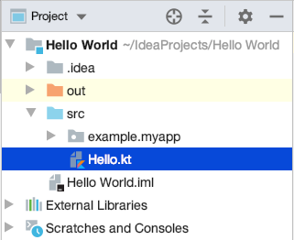
Create a Kotlin file
You should now see a file in the src folder called Hello.kt.

Slide 7
Create a main() function
main() is the entry point for execution for a Kotlin program.
In the Hello.kt file:
fun main(args: Array<String>) {
println("Hello, world!")
}
The args in the main() function are optional.
Notes:
As with other languages, the Kotlin main() function specifies the entry point for execution. Any command line arguments are passed as an array of strings.
Like your earlier printHello() function, this function has no return statement. Every function in Kotlin returns something, even when nothing is explicitly specified. So a function like this main() function returns a type kotlin.Unit, which is Kotlin's way of saying no value.
Note: When a function returns kotlin.Unit, you don't have to specify it explicitly. This is different from some other languages, where you have to explicitly say that you are returning nothing.

Slide 8
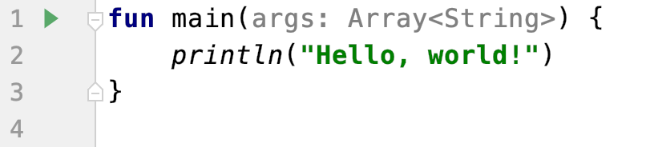
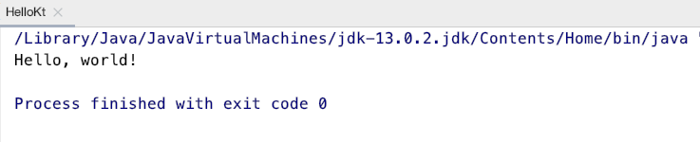
Run your Kotlin program
To run your program, click the Run icon ( ) to the left of the main() function.
IntelliJ IDEA runs the program, and displays the results in the console.

Slide 9
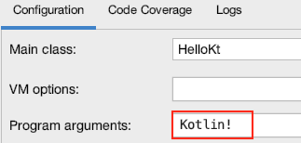
Pass arguments to main()
Select Run > Edit Configurations to open the Run/Debug Configurations window.
Notes:
Enter Kotlin! in the Program arguments field, and click OK.
Because you are running your program from IntelliJ IDEA and not from the command line, you need to specify any arguments to the program a little differently.

Slide 10
Use arguments in main()
Use args[0] to access the first input argument passed to main().
fun main(args: Array<String>) {
println("Hello, ${args[0]}")
}
⇒ Hello, Kotlin!
Notes:
In the previous slide, we passed "Kotlin!" as an argument to main.
In Hello.kt, change the greeting message to use the first argument passed into the program (via the Run/Debug Configurations window on the previous slide), args[0], instead of "world".
This example uses a string template. String templates let you reference variables inside string declarations.

Slide 11
(Almost) Everything has a value

Slide 12
(Almost) Everything is an expression
In Kotlin, almost everything is an expression and has a value. Even an if expression has a value.
val temperature = 20
val isHot = if (temperature > 40) true else false
println(isHot)
⇒ false
Notes:
Declare a val called temperature and initialize it to 20. Then declare another val called isHot and assign the return value of an if/else statement to isHot. Now run the program, and see that the value of the if expression is returned.
Note: Loops are exceptions to "everything has a value." There's no sensible value for for loops or while loops, so they do not have values. If you try to assign a loop's value to something, the compiler gives an error.

Slide 13
Expression values
Sometimes, that value is kotlin.Unit.
val isUnit = println("This is an expression")
println(isUnit)
⇒ This is an expression
kotlin.Unit
Notes:
The first println() prints the string "This is an expression"; the second println() prints the value of the first println() statement.
Some other languages have statements, which are lines of code that don't have a value. In Kotlin, almost everything is an expression and has a value—even if that value is kotlin.Unit. (Kotlin's Unit is equivalent to Java's void.)
To demonstrate, in main() in Hello.kt, we'll write some code to assign a println() to a variable called isUnit, and then print it. Since println() does not return a value, it returns kotlin.Unit.
The Unit Value
Unit is a singleton object, meaning there is only one instance of it.
You can refer to it as Unit or kotlin.Unit.

Slide 14
Functions in Kotlin

Slide 15
About functions
A block of code that performs a specific task
Breaks a large program into smaller modular chunks
Declared using the fun keyword
Can take arguments with either named or default values
Notes:
A function is a discrete block of code that performs an operation, and can return a value. In Kotlin, functions are declared using the fun keyword, and can take arguments with either named or default values. A function associated with a particular class is called a method.

Slide 16
Parts of a function
Earlier, you created a simple function that printed "Hello World".
fun printHello() {
println("Hello World")
}
printHello()
Notes:
You define functions using the fun keyword, followed by the name of the function. As with other programming languages, the parentheses () are for function arguments, if any. Curly braces {} frame the code for the function. There is no return type for this function, because it doesn't return anything.

Slide 17
Unit returning functions
If a function does not return any useful value, its return type is Unit.
fun printHello(name: String?): Unit {
println("Hi there!")
}
Unit is a type with only one value: Unit.
Notes:
Resources:
Unit-Returning Functions
Explicit Return Types

Slide 18
Unit returning functions
The Unit return type declaration is optional.
fun printHello(name: String?): Unit {
println("Hi there!")
}
is equivalent to:
fun printHello(name: String?) {
println("Hi there!")
}
Notes:
Transition: 1 click
Resources:
Unit-Returning Functions
Explicit Return Types

Slide 19
Function arguments
Functions may have:
Default parameters
Required parameters
Named arguments

Slide 20
Default parameters
Default values provide a fallback if no parameter value is passed.
fun drive(speed: String = "fast") {
println("driving $speed")
}
Use "=" after the type
to define default values
drive() ⇒ driving fast
drive("slow") ⇒ driving slow
drive(speed = "turtle-like") ⇒ driving turtle-like
Notes:
In Hello.kt, let's write a drive() function with a String parameter named speed that prints the car's speed. The speed parameter has a default value of "fast".
From the main() function, call the drive() function three ways.
Call the function using the default.
Call the function and pass the speed parameter without a name
Call the function by naming the speed parameter. We'll talk about named arguments, or parameters, later.

Slide 21
Required parameters
If no default is specified for a parameter, the corresponding argument is required.
Required parameters
fun tempToday(day: String, temp: Int) {
println("Today is $day and it's $temp degrees.")
}
Notes:
The tempToday() function takes two parameters, day and temp, both of which are required.

Slide 22
Default versus required parameters
Functions can have a mix of default and required parameters.
fun reformat(str: String,
divideByCamelHumps: Boolean,
wordSeparator: Char,
normalizeCase: Boolean = true){
Has default value
Pass in required arguments.
reformat("Today is a day like no other day", false, '_')
Notes:
In the example function, we use reformat() to apply a specified format, or combination of formats to String. The parameters to reformat() contain their name and type. The normalizeCase parameter has a default value.
Default and named arguments help minimize overloads and improve the readability of your code.

Slide 23
Named arguments
To improve readability, use named arguments for required arguments.
reformat(str, divideByCamelHumps = false, wordSeparator = '_')
It's considered good style to put default arguments after positional arguments, that way callers only have to specify the required arguments.
Notes:
Arguments can be passed to a function with their name (named arguments). Using named arguments is convenient when a function has a large number of parameters or default ones. Note that we did not include the parameter with the default parameter.

Slide 24
Compact functions

Slide 25
Single-expression functions
Compact functions, or single-expression functions, make your code more concise and readable.
fun double(x: Int): Int {
x * 2
}
Complete version
Compact version
fun double(x: Int):Int = x * 2
Notes:
When a function returns a single expression, the curly braces can be omitted and the body is specified after a "=" symbol.
Resource:
Single-Expression Functions

Slide 26
Lambdas and higher-order functions

Slide 27
Kotlin functions are first-class
Kotlin functions can be stored in variables and data structures
They can be passed as arguments to, and returned from, other higher-order functions
You can use higher-order functions to create new "built-in" functions
Notes:
Resources:
Function Types
Higher-Order Functions and Lambdas

Slide 28
Lambda functions
A lambda is an expression that makes a function that has no name.
Parameter and type
Function arrow
var dirtLevel = 20
val waterFilter = {level: Int -> level / 2}
println(waterFilter(dirtLevel))
⇒ 10
Code to execute
Notes:
In addition to traditional named functions, Kotlin supports lambdas. A lambda is an expression that makes a function. But instead of declaring a named function, you declare a function that has no name. Part of what makes this useful is that the lambda expression can now be passed as data. In other languages, lambdas are called anonymous functions, function literals, or similar names.
Like named functions, lambdas can have parameters. For lambdas, the parameters (and their types, if needed) go on the left of what is called a function arrow ->. The code to execute goes to the right of the function arrow. Once the lambda is assigned to a variable, you can call it just like a function.
Resources:
Lambda functions
Lambda Expressions and Anonymous Functions

Slide 29
Syntax for function types
Kotlin's syntax for function types is closely related to its syntax for lambdas. Declare a variable that holds a function.
val waterFilter: (Int) -> Int = {level -> level / 2}
Variable name
Data type of variable
(function type)
Function
Notes:
Here's what the code says:
Make a variable called waterFilter.
waterFilter can be any function that takes an Int and returns an Int.
Assign a lambda to waterFilter.
The lambda returns the value of the argument level divided by 2.
Note that you don't have to specify the type of the lambda argument anymore. The type is calculated by type inference.

Slide 30
Higher-order functions
Higher-order functions take functions as parameters, or return a function.
fun encodeMsg(msg: String, encode: (String) -> String): String {​
return encode(msg)
}
The body of the code calls the function that was passed as the second argument, and passes the first argument along to it.
Notes:
The real power of lambdas is using them to create higher-order functions, where the argument to one function is another function.
Here, allowing the encoder to be passed as a function means you can use better or different encoding algorithms when things change without having to hardcode one into the app. It also provides abstraction by allowing one receiver to be used in different places without specialized code.
Resources:
Lambdas
Higher-order functions

Slide 31
Higher-order functions
To call this function, pass it a string and a function.
val enc1: (String) -> String = { input -> input.toUpperCase() }
println(encodeMsg("abc", enc1))
Using a function type separates its implementation from its usage.
Notes:
Using a function type separates its implementation from its usage letting you use anything that satisfies the contract, in this case anything that takes in a String and returns a String: (String) -> String.

Slide 32
Passing a function reference
Use the :: operator to pass a named function as an argument to another function.
fun enc2(input:String): String = input.reversed()
encodeMessage("abc", ::enc2)
Passing a named function,
not a lambda
The :: operator lets Kotlin know that you are passing the function reference as an argument, and not trying to call the function.

Slide 33
Last parameter call syntax
Kotlin prefers that any parameter that takes a function is the last parameter.
encodeMessage("acronym", { input -> input.toUpperCase() })
You can pass a lambda as a function parameter without putting it inside the parentheses.
encodeMsg("acronym") { input -> input.toUpperCase() }
Notes:
Transition: 1 click
When working with higher-order functions, Kotlin prefers that any parameter that takes a function is the last parameter. Kotlin has a special syntax, called the last parameter call syntax, which lets you make the code even more concise. In this case, you can pass a lambda for the function parameter, but you don't need to put the lambda inside the parentheses.

Slide 34
Using higher-order functions
Many Kotlin built-in functions are defined using last parameter call syntax.
inline fun repeat(times: Int, action: (Int) -> Unit)
repeat(3) {
println("Hello")
}
Notes:
We'll talk more about how higher-order functions can be used in the next section on "List Filters."

Slide 35
List filters

Slide 36
List filters
Get part of a list based on some condition
red | red-orange | dark red | orange | bright orange | saffron
Apply filter() on list
Condition: element contains “red”
red | red-orange | dark red
Notes:
Transitions: timed
Filters are a quick way to get part of a list based on some condition. Here, we apply a list filter to select only colors with "red" in their names.

Slide 37
Iterating through lists
If a function literal has only one parameter, you can omit its declaration and the "->". The parameter is implicitly declared under the name it.
val ints = listOf(1, 2, 3)
ints.filter { it > 0 }
Filter iterates through a collection, where it is the value of the element during the iteration. This is equivalent to:
ints.filter { n: Int -> n > 0 }
OR
ints.filter { n -> n > 0 }
Notes:
Function literals with exactly one parameter don’t require you to define the parameter explicitly; you can just use it. This makes a lot of the language constructs like filter easier to use as you don't have to specify the name of the parameter.
At each step, we can drop the formality because the type system can discern what the content would be expected to be. With it, there's no question what the type would be, and there would only be one value provided to the block of code.

Slide 38
List filters
The filter condition in curly braces {} tests each item as the filter loops through. If the expression returns true, the item is included.
val books = listOf("nature", "biology", "birds")
println(books.filter { it[0] == 'b' })
⇒ [biology, birds]
Notes:
Let's use a filter to print only the decorations that start with the letter "b". The output captured by the filter is shown in the result.

Slide 39
Eager and lazy filters
Evaluation of expressions in lists:
Eager: occurs regardless of whether the result is ever used
Lazy: occurs only if necessary at runtime
Lazy evaluation of lists is useful if you don't need the entire result, or if the list is exceptionally large and multiple copies wouldn't fit into RAM.
Notes:
Lazy operations are more expensive individually (due to an increase in small allocations and branches) than eager ones, and they should be limited to when there is a known benefit. Using lazy evaluation is especially helpful when working with large collections where you want to avoid performing expensive operations when you only need part of the results.

Slide 40
Eager filters
Filters are eager by default. A new list is created each time you use a filter.
val instruments = listOf("viola", "cello", "violin")
val eager = instruments.filter { it [0] == 'v' }
println("eager: " + eager)
⇒ eager: [viola, violin]
Notes:
In Kotlin, the result list can be created immediately, or when the list is accessed. That is, it can be either eager or lazy depending on which way you need it to be. By default, filter is eager, and each time you use the filter, a list is created.
To make the filter lazy, you can use a Sequence, which is a collection that can only look at one item at a time, starting at the beginning, and going to the end. Conveniently, this is exactly the API that a lazy filter needs.
Resource:
Sequences

Slide 41
Lazy filters
Sequences are data structures that use lazy evaluation, and can be used with filters to make them lazy.
val instruments = listOf("viola", "cello", "violin")
val filtered = instruments.asSequence().filter { it[0] == 'v'}
println("filtered: " + filtered)
⇒ filtered: kotlin.sequences.FilteringSequence@386cc1c4
Notes:
Sequences let you process elements one by one until a filtering condition is satisfied, reducing unnecessary processing.
Here we evaluate the filter using a Sequence with asSequence(). Assign the sequence to a variable called filtered, and print it.
When you return the filter results as a sequence, the filtered variable won't hold a new list, it will hold a sequence of the list elements and knowledge of the filter to apply to those elements. Whenever you access elements of the sequence, the filter is applied, and the result is returned to you.

Slide 42
Sequences -> lists
Sequences can be turned back into lists using toList().
val filtered = instruments.asSequence().filter { it[0] == 'v'}
val newList = filtered.toList()
println("new list: " + newList)
⇒ new list: [viola, violin]
Notes:
Force evaluation of the sequence by converting it to a list with toList(), and print the result.

Slide 43
Other list transformations
map() performs the same transform on every item and returns the list.
val numbers = setOf(1, 2, 3)
println(numbers.map { it * 3 })
=> [3, 6, 9]
flatten() returns a single list of all the elements of nested collections.
val numberSets = listOf(setOf(1, 2, 3), setOf(4, 5), setOf(1, 2)) println(numberSets.flatten())
=> [1, 2, 3, 4, 5, 1, 2]
Notes:
Transition: 1 click
Resource:
Collection Transformation Operations

Slide 44
Summary

Slide 45
Summary
In Lesson 2, you learned how to:
Create a file and a main() function in your project, and run a program
Pass arguments to the main() function
Use the returned value of an expression
Use default arguments to replace multiple versions of a function
Use compact functions, to make code more readable
Use lambdas and higher-order functions
Use eager and lazy list filters

Slide 46

Pathway
Practice what you’ve learned by completing the pathway:
Lesson 2: Functions

